Slide 1

Team Lead 1
Presentation
Presented by: Dawson Burgess, Bryce Hendrickson, Cole Halvorson

Slide 2
Important Due Dates coming up

Slide 3
Platformer Game - Sept 20th
Champion Doc - Sept 17th
RFP - Sept 21st
SA (systems analysis) presentation - Sept 22nd
TL2 presentation (minimum viable product) - Sept 29th

Slide 4
Git: Overview - Dawson

Slide 5

What is GIT?
Git is a tool used for source code management.
It is a free and open-source version control system used to handle small to very large projects efficiently.
Git is used to track changes in the source code, enabling multiple developers to work together on non-linear development.

Slide 6
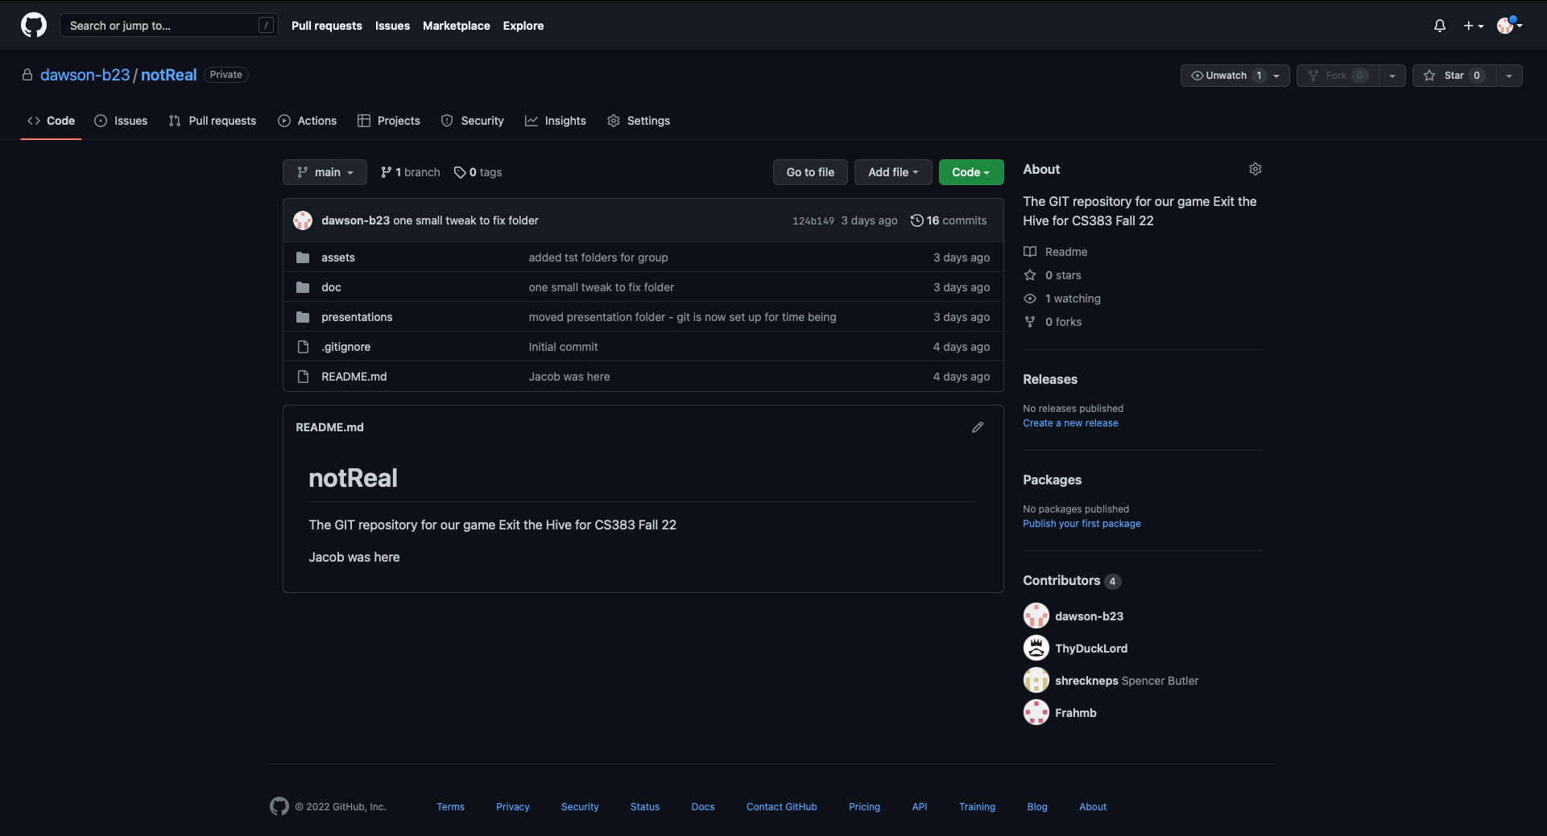
What is the difference between Github and GIT?
In simple terms, Git is a version control system that lets you manage and track your source code history.
GitHub is a cloud-based hosting service that lets you manage Git repositories. If you have any projects (open source) that use Git, then GitHub acts as a way to better manage them.

Slide 7
More on Version control
Version control, also known as source control, is the practice of tracking and managing changes to software code. Version control systems are software tools that help software teams manage changes to source code over time.
This will be very important to the class as time progresses in the projects. Later on, if there is a mistake and the code is suddenly not working, you can revert to a working version or until the changes that cause it to crash are found.

Slide 8
Why do we need to use it?
In theory, you could do the whole project with absolutely no GIT or version control at all - but it would be incredibly difficult, especially with a team.
Version control systems (GIT) allow multiple developers, designers, and team members to work together on the same project. It helps them work smarter and faster! A version control system is critical to ensure everyone has access to the latest code and modifications are tracked.

Slide 9
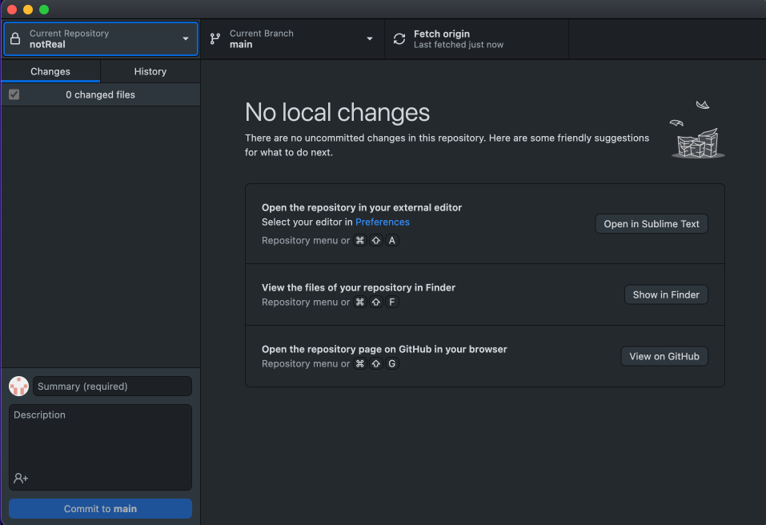
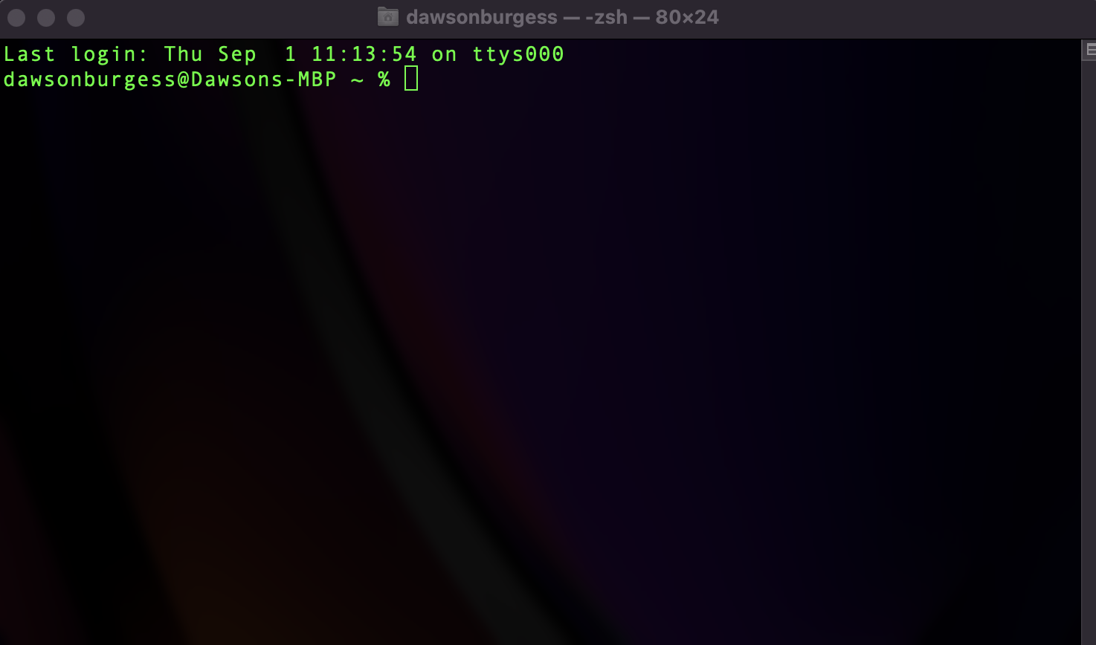
Command Line Vs GitHub Desktop
GIT was originally designed and integrated using the command line, but that is often intimidating towards inexperienced users
There is also a Github desktop application that will solve this if you are intimidated/uncomfortable with the command line.
Specifics of how to use both will be covered in later sections of this presentation.

Slide 10
Git: Getting Started | Command line version - Bryce

Slide 11
Git: Getting Started - Overview
Account creation
Creating a repository
Installing Git access for PC (Git bash) & Mac (Command Line)
Setting up an access tokens
Git global variables

Slide 12
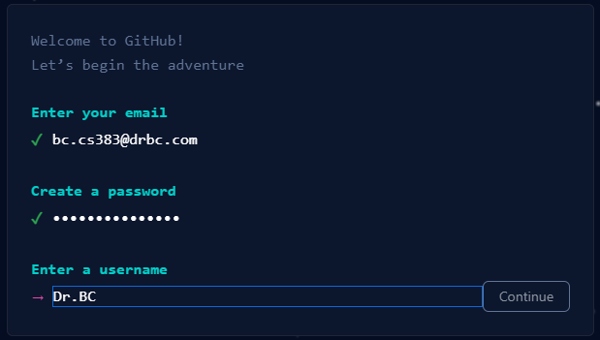

GitHub - Account Creation | github.com
Start with creating an account for GitHub
Enter email and create a password
Enter a username

Slide 13
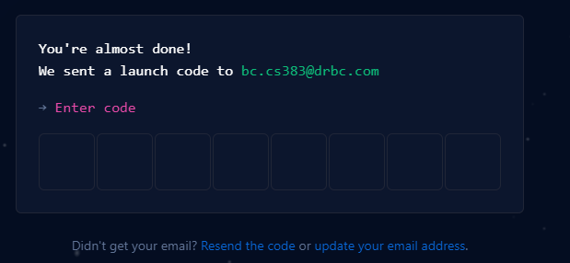
GitHub - Account Creation | github.com
Verify email

Slide 14
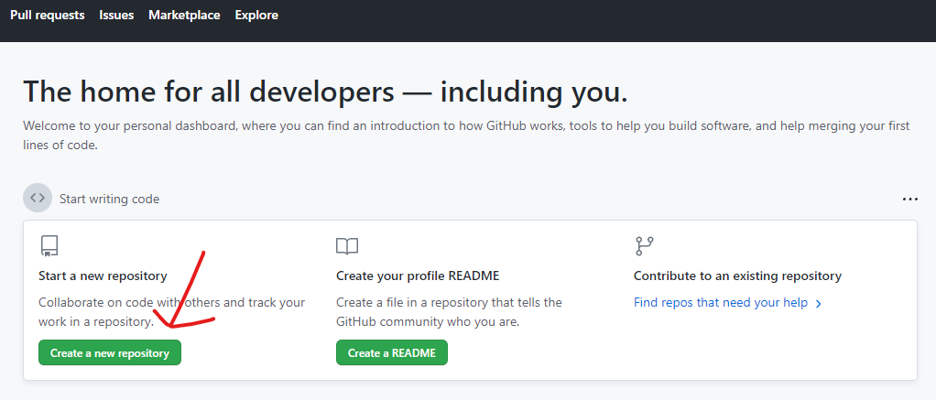
GitHub - Creating a repository
Sign in at github.com & click “Create a new repository”

Slide 15
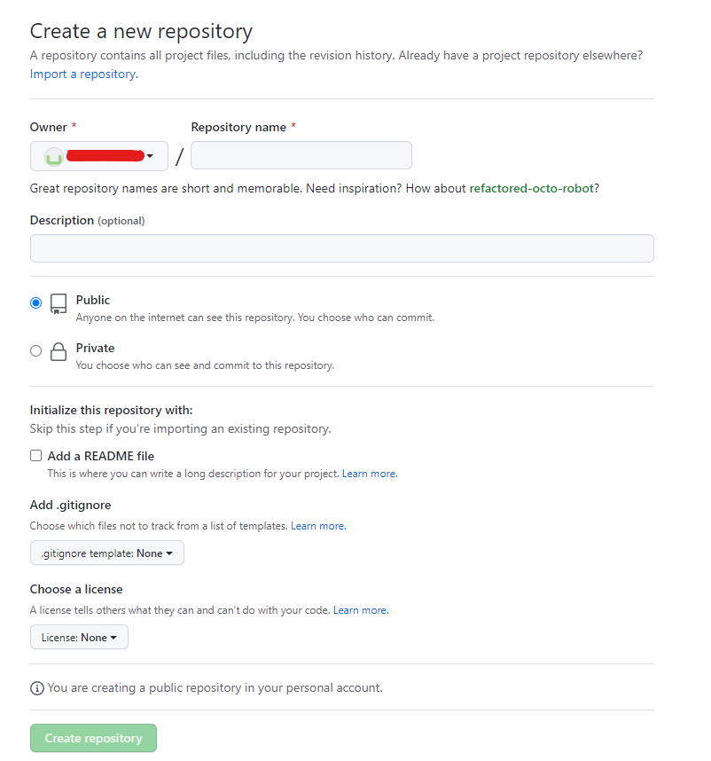
GitHub - Creating a repository
Name
Description
Public / Private
README?
Gitignore?
License?

Slide 16
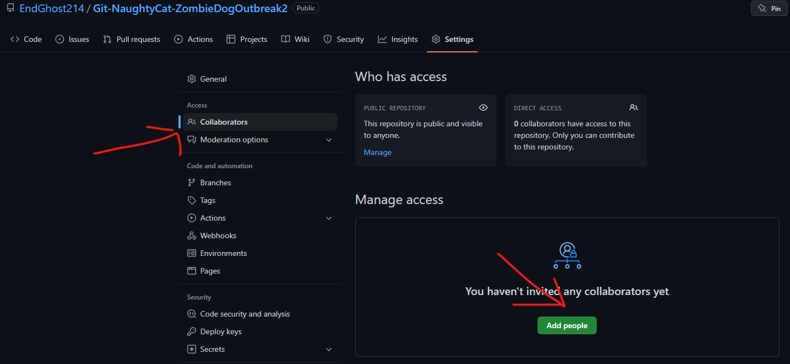
GitHub - Set up Repository for Collaboration
Navigate to repository settings
Click on collaborators
Click add people & add all usernames of collaborating members.

Slide 17
Installing Git on Local Machine
Mac - Git comes preinstalled on macOS
Pc - Must download Git
Most popular variant is Git Bash

Slide 18
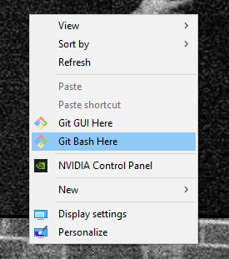
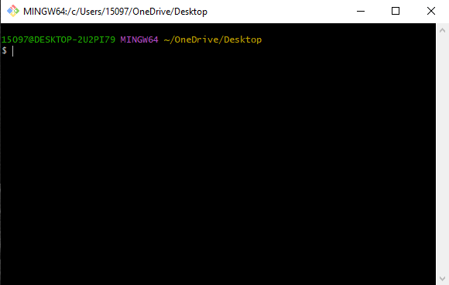
Git - how to interact with GitHub
PC - right click and bring up Git Bash
Mac - go to command line

Slide 19
Git - Login
Must login to git to access GitHub
Must establish username, email & password
Do not establish account password for local git - use a personal access token instead
Why?
Must configure login credentials
Must proc access request
Usually from a pull request

Slide 20
Git - Personal Access Tokens
Navigate to your GitHub account
GitHub -> Profile settings -> Developer settings -> Personal Access tokens -> Generate new token

Slide 21
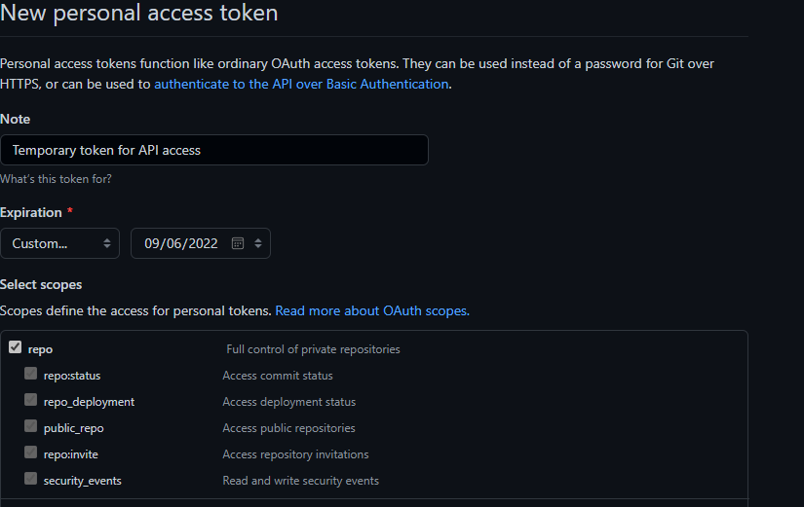
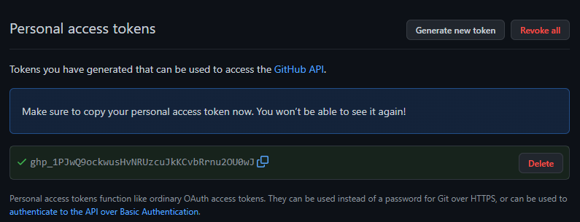
Git - Personal Access Tokens Continued
Note
Expiration
Access Scopes
We will just use repo for our purposes

Slide 22
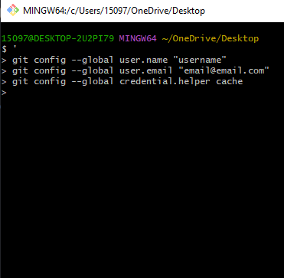
Git - Login Configurations
git config --global user.name "username"
Establish username
git config --global user.email "email@email.com"
Establish email
git config --global credential.helper cache
Saves password / access token from login
Git config -l
Lists all config settings

Slide 23
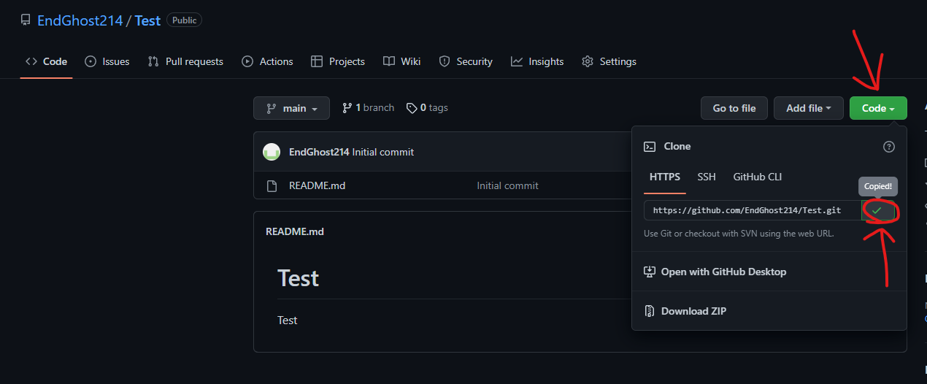
Git - Let’s login!
Navigate to GitHub profile repositories
Use the repository that was previously created & copy the HTTPS link to the repository

Slide 24
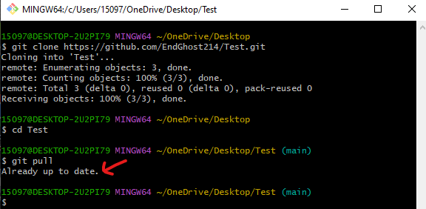
Git - Let’s login!
Clone repository
Request a pull once in repository
Password request will appear on line pointed to by the arrow below - enter personal access token and never login again until token expires!

Slide 25
Using Git: The Basics - Cole

Slide 26
The Big Idea
Once we’ve set up our repository, it’s time to start versioning our code
First we’ll need to clone our repository onto our local machine
Next we’ll pull to make sure we’re up to date
Next we’ll make some changes or add some files locally
Next we’ll add our files to a new commit
Then we’ll commit our changes
Finally we’ll push our new commit onto the main branch

Slide 27
Git: Clone
What is cloning?
When you clone a repository, you’re downloading a copy of all of the files you have in that repository on github onto your machine
Now you have two versions of your repository!
Local, on your machine. This is where we make changes
Remote, on github. This is where we save versions of our code

Slide 28
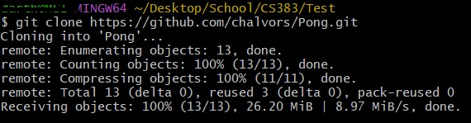
Git: Cloning a Repository Using Git Bash
Navigate to your desired directory
Type “git clone <repository>”
Now my Pong repository is on my local machine

Slide 29
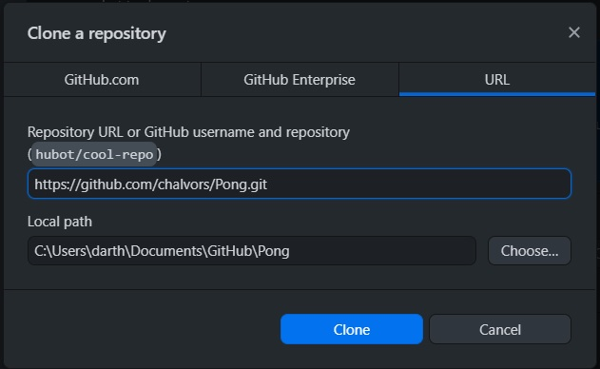
Git: Cloning a Repository Using GitHub Desktop
Click on the “Current Repository” button in the top left
Click “Add”
Click “Clone repository…”
Paste repository github link
Specify desired path
Click “Clone”
Now you’ll see your repository in the list at the top left on the home page

Slide 30
Git: Pull
The pull command incorporates changes from a remote repository into the current branch
This is how we get the latest changes from the repository onto our machines
In order to see other people’s changes to the project, we need to execute a pull

Slide 31
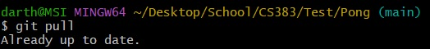
Git: Pulling Using Git Bash
Navigate to the repository directory
Type “git pull”
We’re up to date!

Slide 32
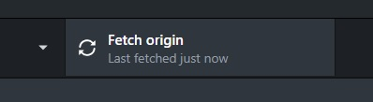
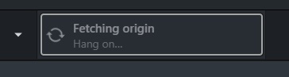
Git: Pulling Using GitHub Desktop
Click the “fetch origin” button in the top right
Wait
We’re up to date!

Slide 33
Git: Status
The status command displays the state of the working directory and the staging area.
Working Directory: umbrella term for all files and folders for your project
Staging Area: files that are waiting to be committed

Slide 34
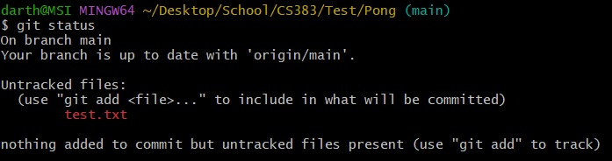
Git: Checking Status Using Git Bash
Navigate to git repository directory
Type “git status”

Slide 35
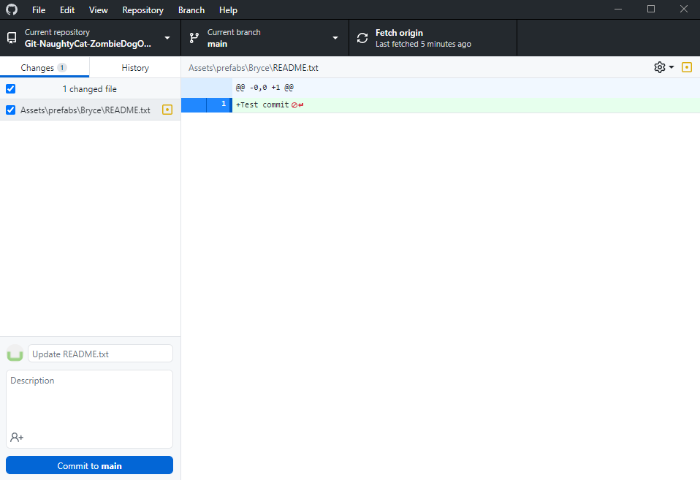
Git: Checking Status Using GitHub Desktop
Status is automatic
Changes automatically appear in the left column
Click on the change to see a preview of the file and how it changed

Slide 36
Git: Add
The add command is one of the commands we will use most often, it adds a change in the working directory to the staging area
These can be existing files we’ve made changes to or new files we’ve created since our last commit
Any change in the working directory must be added before committing

Slide 37
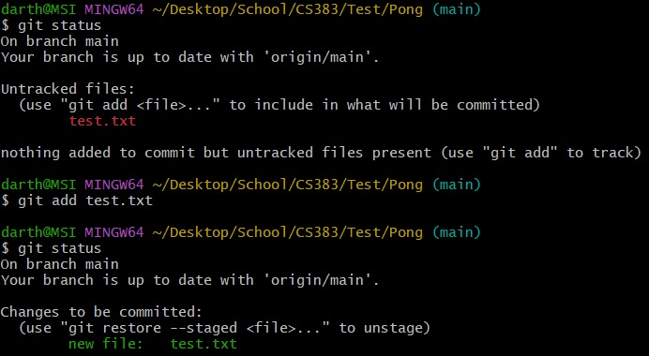
Git: Adding using Git Bash
Navigate to the repository directory
Type “git add <file>”
Now our changed file has been moved to the staging area and is ready to be committed

Slide 38
Git: Adding Using GitHub Desktop
Adding is super easy, just select the checkbox on the left for the files you want added to your commit
Changes are automatically added to the next commit by default

Slide 39
Git: Commit
The commit command records changes to the repository
Commits are how we record the history of our project
Commits have log messages
It’s very important to write good log messages for your commits, that way other people know what you changed
When our project is done, we should see a long chain of commits, each with a clear log message describing what was changed

Slide 40
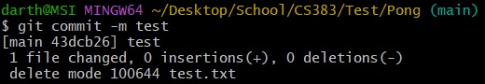
Git: Committing Using Git Bash
Navigate to the repository directory
Type “git commit -m <log-message>”
4) We’ve made a commit on the main branch!
Note: the “-m” option lets us enter a log message for our commit right in the command line. If you do not include a “-m” in your commit command Git Bash will open up a vi editor and make you write a log message in there. We recommend using the “-m” option, it’s just easier.

Slide 41
Git: Committing Using GitHub Desktop
Make sure the changes you wish to commit are checked
Write a log message in the provided box
Click the “Commit to main” button in the bottom left

Slide 42
Git: Push
The push command is used to upload local repository content to a remote repository
This is how we put our local changes onto GitHub
You might also think of it as updating the remote repository to look like your local repository
We push our local commits to the remote repository
Kind of the opposite of pull

Slide 43
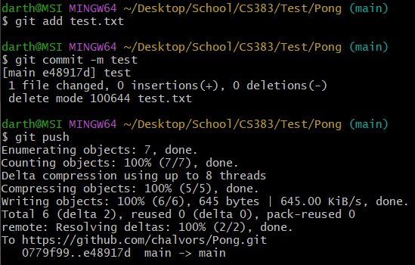
Git: Pushing Using Git Bash
Navigate to the repository directory
Ensure you have commits ready to be pushed
Type “git push”
We’ve pushed our first commit!

Slide 44
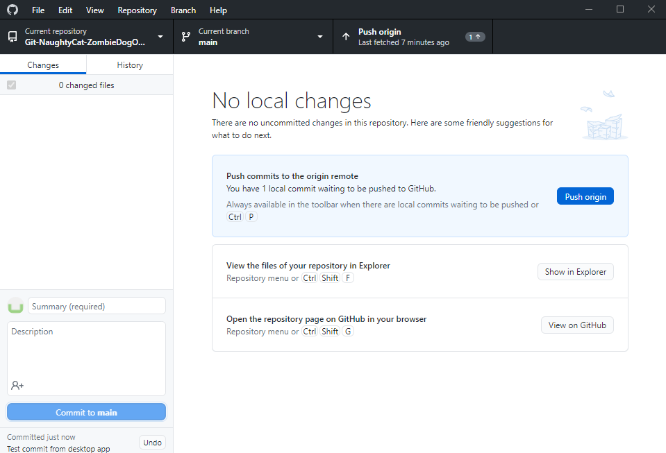
Git: Pushing Using GitHub Desktop
Commited changes
Prompting to push
Click either of the “Push origin” buttons

Slide 45
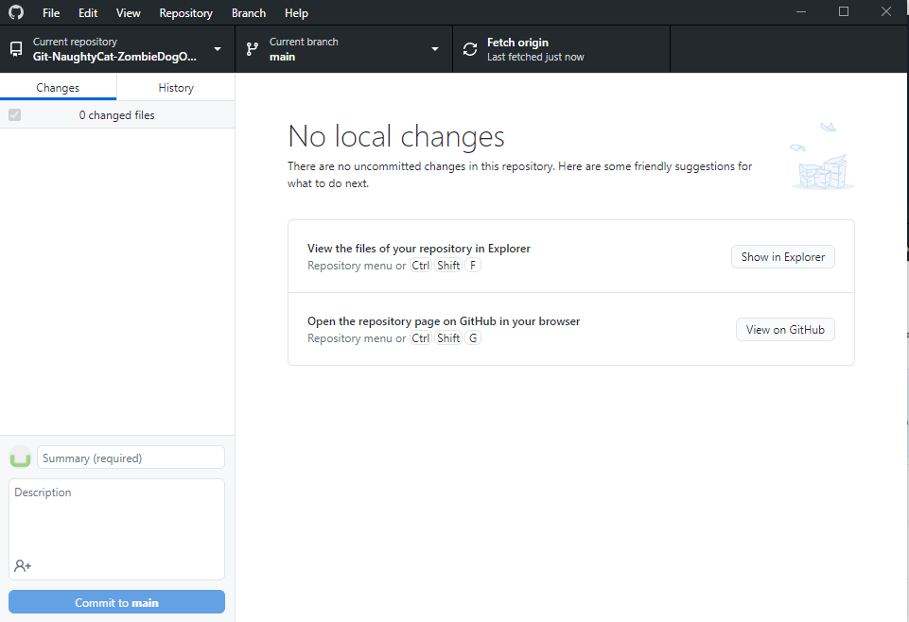
GitHub Desktop - Post Push
Back to no changes

Slide 46
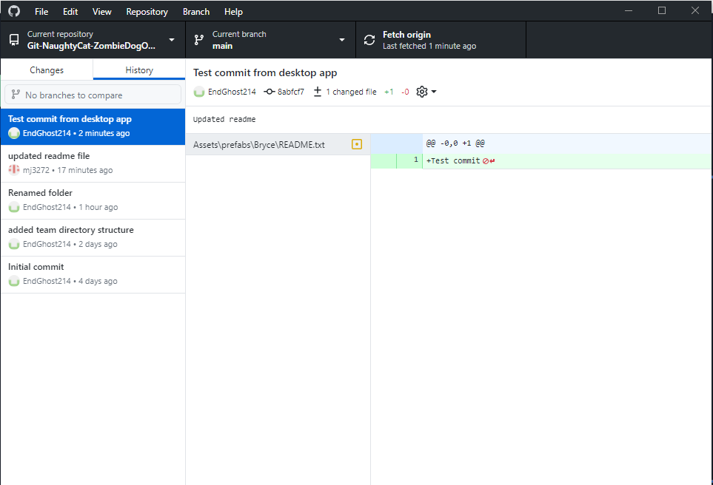
GitHub Desktop - History
History tab shows all commits on current branch

Slide 47
A quick note on branches
We will not be making branches and merging them into main. Instead we will be committing directly to the main branch
If you know how to make branches and do merges:
Good, you’ll use that in the future
We won’t be doing that for this class
“Never commit to master”
If you don’t know what any of that means:
Don’t worry about it :)
There are lots of really cool and fancy git commands
Feel free to learn them, knowing git is super important
Don’t use anything crazy for your games, keep it simple!

Slide 48
Git Bash VS GitHub Desktop
GitHub Desktop makes everything really easy!
That’s why we strongly encourage you all to use the command line :)
The command line forces you to understand what you’re doing
We’ve done lots of Bash before, it shouldn’t be too intimidating
If you’re really struggling to use the command line you can fall back on GitHub Desktop
At the end of the day they do the same thing but we think you’ll learn a lot more using the command line

Slide 49
Git Bash + GitHub Desktop Downloads
Git Bash: https://git-scm.com/downloads
GitHub Desktop: https://desktop.github.com/

Slide 50
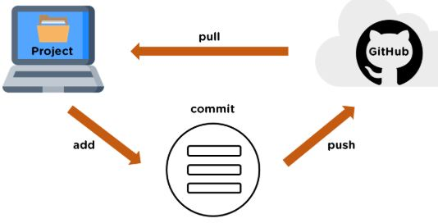
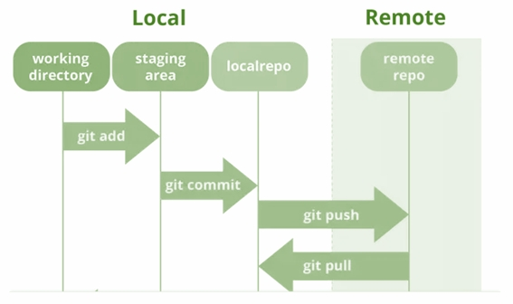
Git: Tying it All Together
Some Useful Pictures

Slide 51
Git - Live Tutorial - Bryce

Slide 52
Other deliverables - All

Slide 53
Platformer Game due Sept 17th

Slide 54
Platformer Game - Description and goals
Use Unity and C# to create a Platformer video game or an equivalent game. Your game must include the following elements:
An animated main player that moves in response to the user pressing keys on the keyboard or mouse (or in response to the controller moving if using Vive)
Move left
Move right
Jump
Health Bar
At least one item should remove health
Score Bar
Items picked up should add to score
Level Goal that needs the player to jump on at least three platforms to reach.
Sound.
Nice graphics.

Slide 55
Platformer Game - Deliverables
Code (30 marks)You can either submit a .zip file, or give a link to a GIT repository where (BC) can clone your code, or use the delivery method you are most comfortable with.
On the demo day show all aspects of the items above to the class (on one of your team's laptops).
Note: This is a group assignment with the people how have the same TL number as you have.

Slide 56
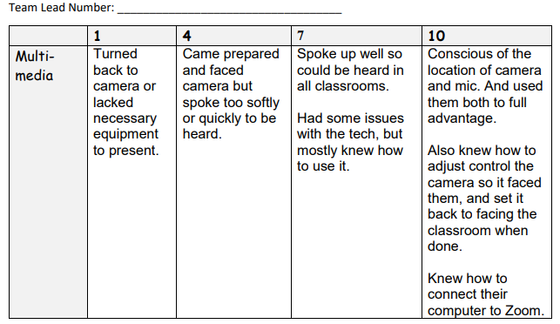
Platformer Game - Marking Key Sept 17th
Overall game (Sound, graphics, understandable goal) (10 marks)
Main player (Movement, graphics (animated)) (10 marks)
Other (Health Bar, Score Bar) (10 marks)
MultiMedia:

Slide 57
Champion Document due Sept 17th
Champion - OneDrive (sharepoint.com)

Slide 58
RFP (request for proposal) due Sept 21st
RFP - OneDrive (sharepoint.com)

Slide 59
SA (system analysis) presentation

Slide 60
Everything that will be due on presentation day:
RFP - due the day before the presentation
Presentation
Storyboard
Global Use Case
Context diagram and Diagram 0
Individual Use Case Diagrams
Champion
Use case diagram & scenario
Data flow diagram
Test plan (rough since you have not learned this yet)
Gnatt and Pert charts
Peer Evaluations

Slide 61
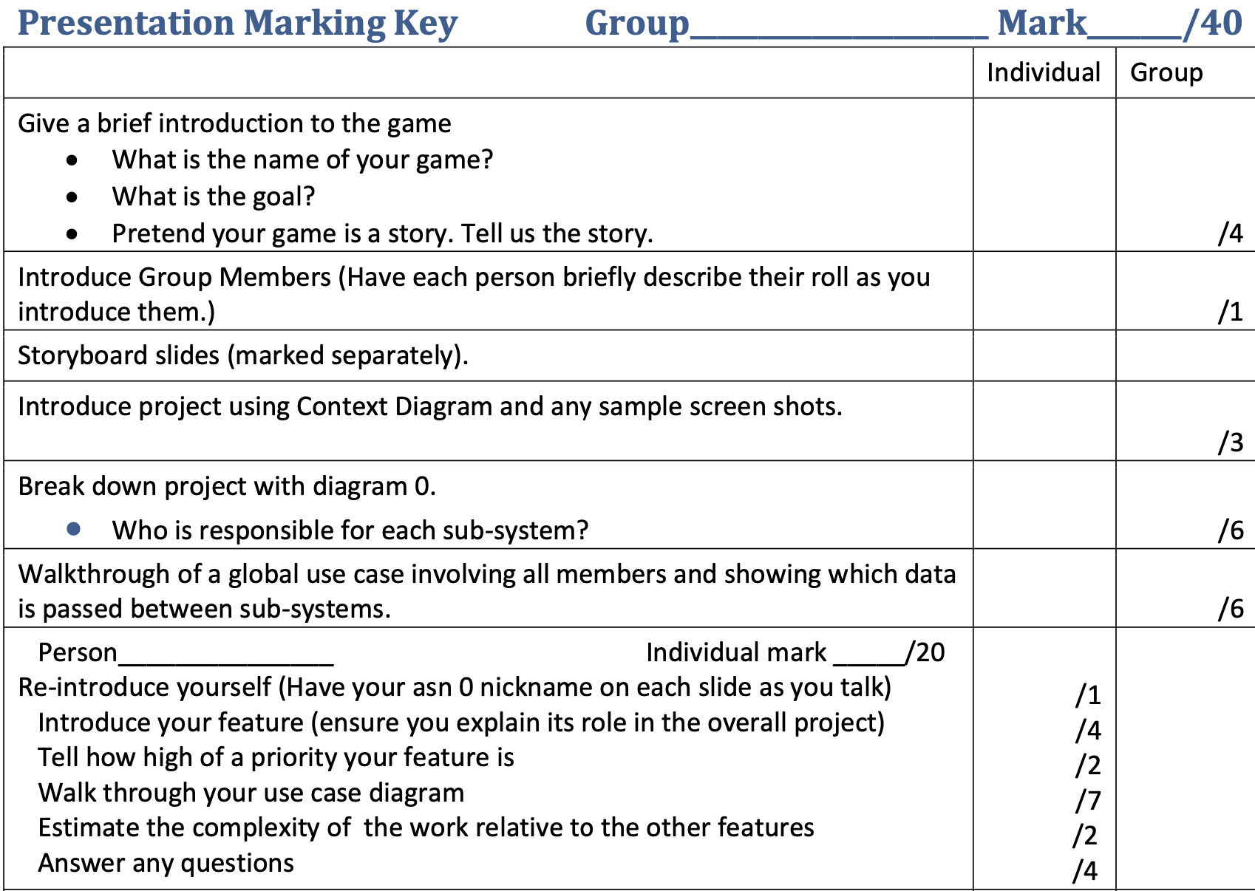
SA Presentation Marking key (available on Dr BC’s Website)

Slide 62
SA: StoryBoard
Needed for SA and RFP

Slide 63
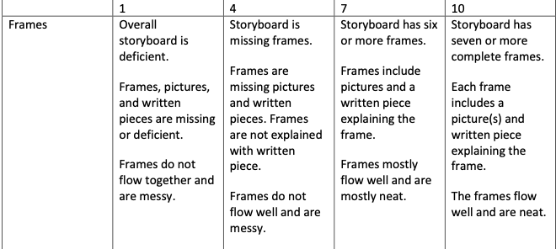
Storyboard Marking key (separate marking key from SA presentation)

Slide 64
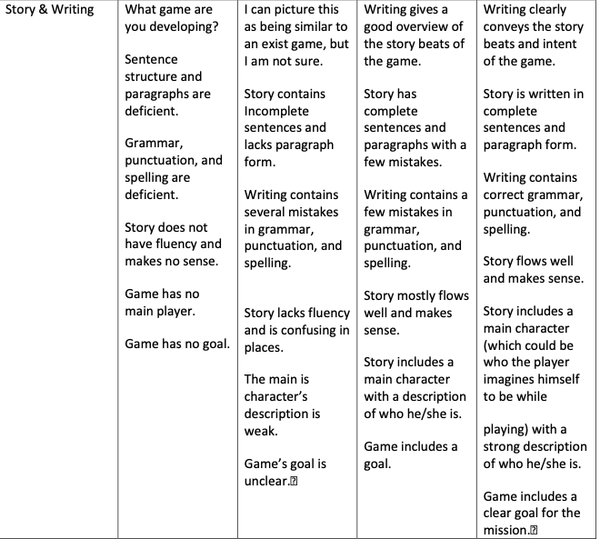
Storyboard Marking key (separate marking key from SA presentation)

Slide 65
Where does this fall in the SDLC?
Specification
Design and implementation
Validation
Evolution

Slide 66
What is a storyboard?
Storyboards are visual representations that aid in the creation process of digital story writing.
Storyboards lay out images in sequential order to create the flow of the production.
They can also include technical aspects and explanations of design.
A storyboard visually tells the story panel by panel, kind of like a comic book or slideshow presentation.

Slide 67
Why a storyboard?
Creating a storyboard will help you plan your video game out shot by shot.
You can make changes to your storyboard before you start animating and coding, instead of changing your mind later.
You will also be able to talk about your game and show your storyboard to other people to get feedback on your overall ideas, and less about the technical coding side.
This makes it ideal to pitch to a team of executives, potential investors, etc.

Slide 68
What makes a storyboard?
A storyboard conveys the following information:
What characters are in the frame, and how are they moving/interacting with the game?
What are the characters saying/doing to each other, if anything?
How much time has passed between the last frame of the storyboard and the current one?
Where the “camera” is in the scene? Close or far away? Is the camera moving, still, following the player, or triggered by something?

Slide 69
Beat board vs. Storyboard
A beat board is basically the same thing as a storyboard with the exception of having less overall detail.
It has the idea in around 9-16 images but without all the additional detail of shot type, camera angle and speech/interactions.
It is perfect for a short pitch as you can get the bulk of your general idea across without having to go into specific details.

Slide 70
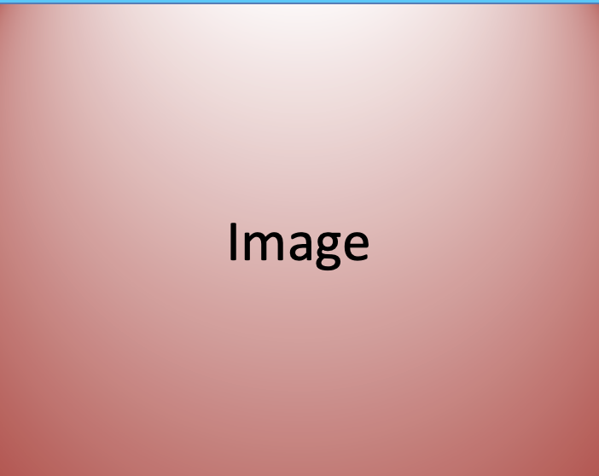
Your Storyboard somewhere between a storyboard and a beatbox:
Action
Dialog
Notes

Slide 71
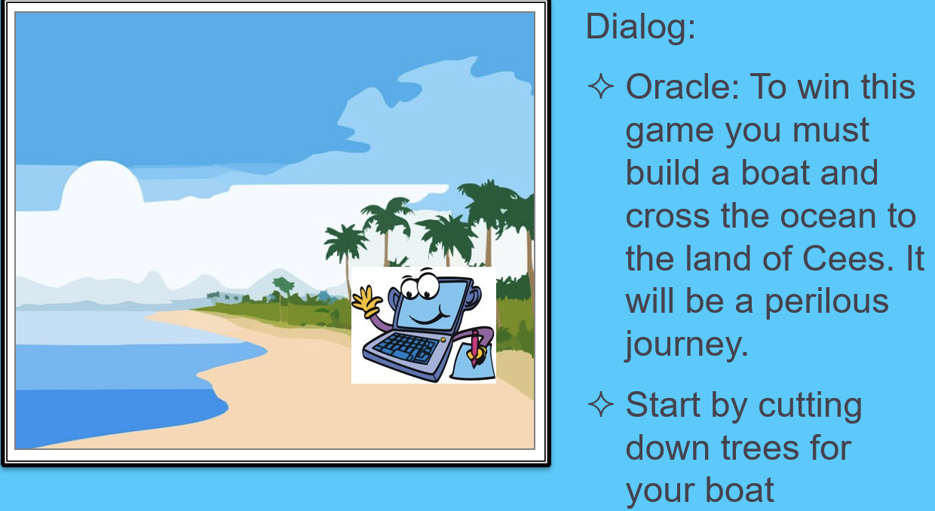
Far too short example from Dr BC:

Slide 72
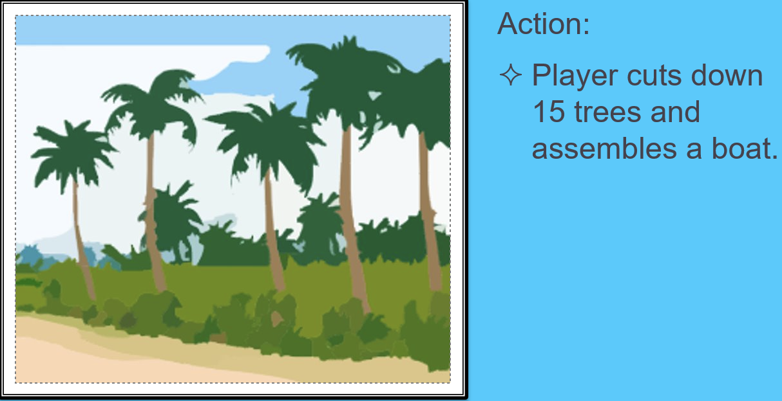
Far too short example from Dr BC:

Slide 73
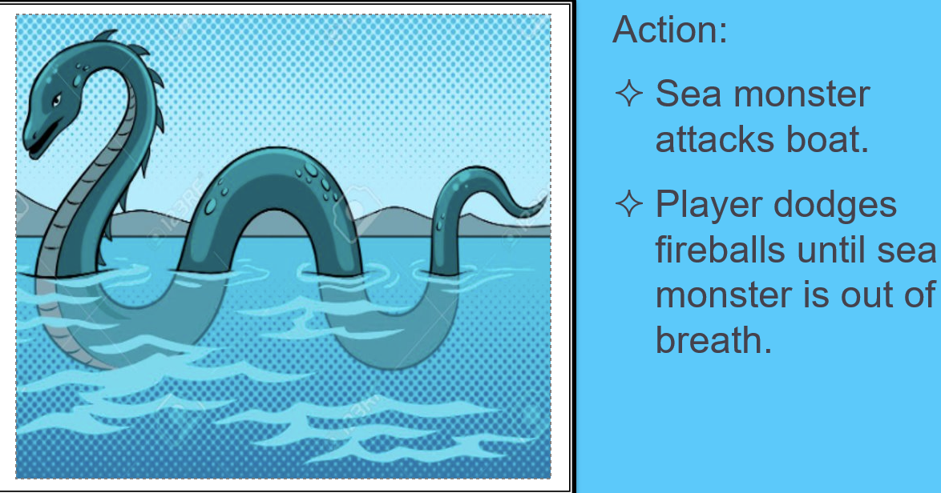
Far too short example from Dr BC:

Slide 74
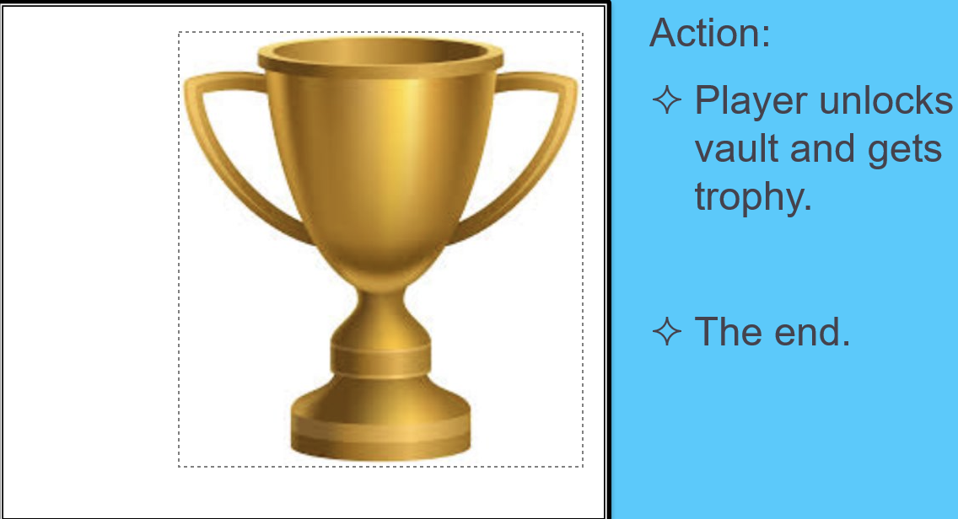
Far too short example from Dr BC:

